Slide 1
Bajaj Finance vs Mahindra Finance
Credit risk through the 7 Cs, backed by a quantitative Credit Risk Index
FY2017-18 to FY2025-26 | Consolidated basis | October 2026
Notes:
Welcome. The question for today is simple: Bajaj Finance and Mahindra Finance are both large Indian non-bank lenders, so which one is the riskier credit, by how much, and why? We answer it in two layers. First we use the classic 7 Cs of credit as a checklist. Then we combine the measurable parts into one score, the Credit Risk Index, and stress-test it. Suggested timing is about 30 minutes: 4 minutes on the frame and context, about 15 on the seven Cs, 7 on the index and its robustness, and 4 on conclusions. The appendix holds backup tables for questions.

Slide 2
Bajaj is the lower credit risk, but the gap has narrowed from 40 to 14 points
EXECUTIVE SUMMARY
9-yr AUM CAGR
Gross NPA, FY26
RoA, FY26
Credit Risk Index, FY26
Bajaj
Bajaj
Bajaj
Bajaj
26.8%
1.01%
4.30%
18.8
Mahindra
Mahindra
Mahindra
Mahindra
12.9%
3.34%
1.89%
33.1
Notes:
Start with the answer so the audience knows where we are heading. Bajaj grew about twice as fast, has bad loans of 1.0 percent against 3.3 percent, and earns more than twice the return on assets. On our combined Credit Risk Index, higher means riskier, Bajaj scores 18.8, which is Low, and Mahindra 33.1, which is Moderate. The key twist is the bottom line: Mahindra is riskier because of old bad loans and thinner buffers, not because of what it is losing today. Everything that follows explains and tests this. Transition: first, how we structure the assessment.

Slide 3
FY26 scorecard: Bajaj wins on every measure except credit cost
EXECUTIVE SUMMARY
Metric | 7 C | Bajaj Finance | Mahindra Finance | Better
AUM (₹ Cr) | Context | 509,975 | 143,405 | Bajaj
3-year AUM CAGR (%) | Context | 27.3 | 16.8 | Bajaj
Gross NPA (%) | Collateral | 1.01 | 3.34 | Bajaj
Net NPA (%) | Collateral | 0.41 | 1.40 | Bajaj
Provision coverage (%) | Collateral | 60.0 | 58.9 | Bajaj (slightly)
Credit cost (%) | Capacity | 2.22 | 1.83 | Mahindra
RoA (%) | Capacity | 4.30 | 1.89 | Bajaj
RoE (%) | Capacity | 18.10 | 11.85 | Bajaj
Cost-to-income (%) | Capacity | 32.8 | 47.6 | Bajaj
CRAR (%) | Capital | 21.55 | 18.80 | Bajaj
Credit Risk Index (lower = safer) | Synthesis | 18.8 | 33.1 | Bajaj
Notes:
This table is the summary, and it already shows which of the 7 Cs each measure belongs to, so you can see the link between the framework and the numbers. Bajaj is better on everything except credit cost, where Mahindra is slightly lower at 1.83 against 2.22 percent. Provision coverage is nearly equal. Mention the caution on the slide: two companies, nine years, thresholds are our judgement. Transition: now let us see how the 7 Cs frame is built.

Slide 4
The 7 Cs are the frame; financial ratios are the evidence
C | The question it asks | Ratios we use | Type
Character | Is management and governance trustworthy? | None; regulatory record, ownership, track record | Qualitative
Capacity | Can it earn enough through the cycle? | RoA, RoE, cost-to-income, credit cost, loan losses / income | Ratios
Capital | Can it absorb losses? | CRAR, Tier 1, headroom over 15%, leverage | Ratios
Collateral | How good and how secured is the loan book? | Gross NPA, net NPA, PCR, Stage 2, unsecured and high-risk share | Ratios
Conditions | Do industry and regulation help or hurt? | None; rate cycle, RBI rules. FY21 stress as evidence | Qualitative
Cash flow | Can it fund itself and stay liquid? | Cost of funds, leverage (ALM gaps not in our data) | Ratios
Covenants/context | Ratings, group support, borrowing terms | None; rating reports, group ties | Qualitative
Notes:
The 7 Cs are a classic credit checklist: Character, Capacity, Capital, Collateral, Conditions, Cash flow and Covenants or context. For a lender such as an NBFC, four of them can be measured with ratios from the financial statements: Capacity, Capital, Collateral, which for a lender means the quality and security of its loan book, and Cash flow, meaning funding and liquidity. The other three are judgement calls based on public record: Character, Conditions and Covenants. We do not force numbers onto those. In the next slides, each C gets a table showing exactly which ratios we use, the formula, and how to read it. Transition: first a quick note on the data.

Slide 5
The data: ten years, reported numbers, five integrity checks passed
The panel
5 checks, all passed
What is estimated
20 company-year rows
64 columns
154 product rows
Consolidated basis
FY17 to FY26 (scoring uses FY18 to FY26)
Net NPA never above gross
CRAR never below Tier 1
Cost ratio recomputes within 0.1 pt
Gross NPA % matches amounts
Product shares sum to 100%
Bajaj net worth, assets, borrowings, write-offs
One-time provisions
FY17 stage data for both
Headline credit ratios are reported, not estimated.
Notes:
A short word on the data, because everybody will ask. The panel is one row per company per year on a consolidated basis, with 20 company-year rows. We ran five consistency checks and all passed. For example, net bad loans are never above gross bad loans. Some inputs were estimated, mainly one-time provisions and Bajaj's net worth, total assets and borrowings. That is why Bajaj's debt-to-equity is the least reliable ratio and we do not use it. All the headline ratios we rely on, gross and net NPA, credit cost, provision cover and capital ratios, are reported values. We use FY18 to FY26 for scoring because FY17 is before Ind AS and its stage data are estimated. Transition: before the 7 Cs, here is the starting point for the two companies.

Slide 6
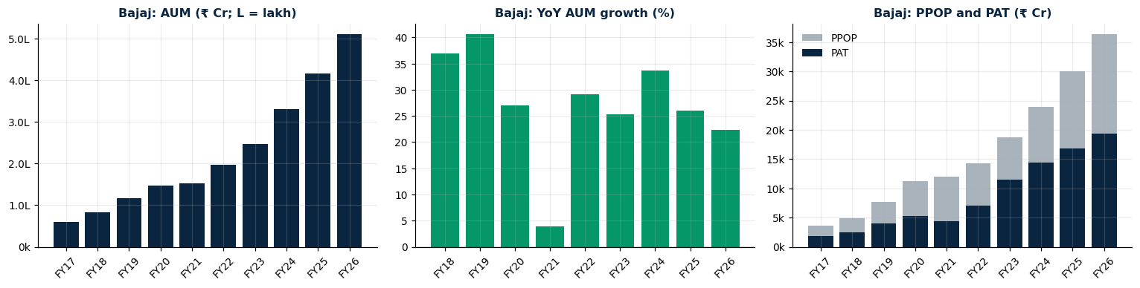
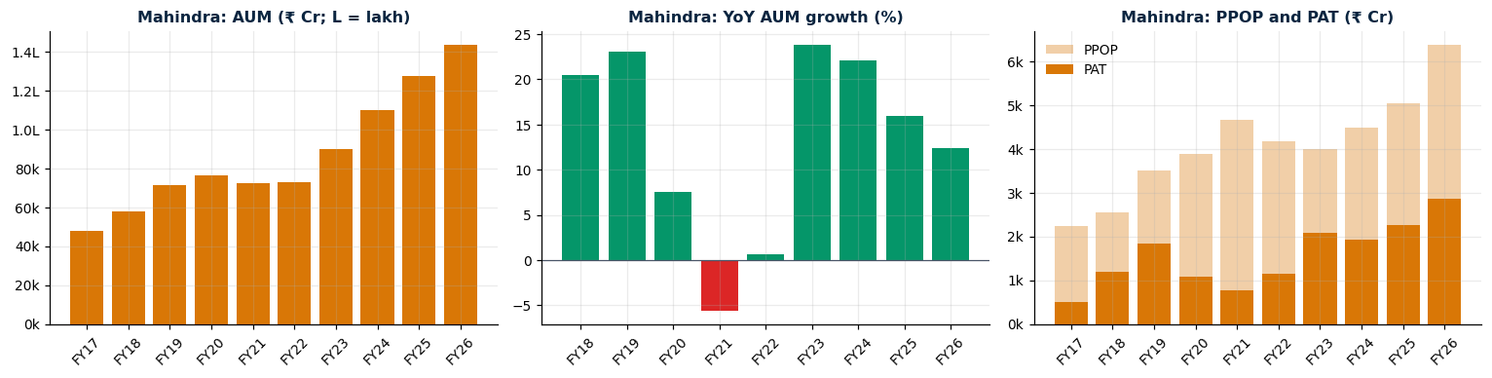
Overview: Bajaj compounded, Mahindra stalled during COVID
Bajaj Finance (Figure 2)
AUM ₹60,196 Cr to ₹509,975 Cr
26.8% a year
FY21 growth only about 4%, then back to 29%
Mahindra Finance (Figure 7)
AUM ₹47,994 Cr to ₹143,405 Cr
12.9% a year
FY21 AUM fell 5.5%, FY22 flat
Notes:
Set the scene before the Cs. Top row is Bajaj: AUM, the loan book it manages, rises every year, with one pause in FY21 when growth fell to about 4 percent before bouncing back to 29 percent. Bottom row is Mahindra: its book shrank 5.5 percent in FY21, the only contraction in the study, and barely grew in FY22, so its stress lasted about two years. In the profit panels on the right, in FY21 provisions took most of the pre-provision profit at both companies, roughly two thirds at Bajaj and roughly four fifths at Mahindra. Profit values are read from the charts so they are approximate. Transition: this difference in COVID experience drove a big divergence in size.

Slide 7
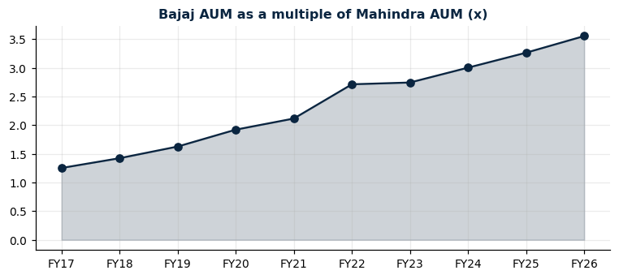
Bajaj is now 3.6 times the size of Mahindra
What the chart shows
Bajaj AUM / Mahindra AUM: 1.25x (FY17), 2.1x (FY21), 2.7x (FY22), 3.56x (FY26).
What it means
They started at similar scale and diverged sharply.
The biggest jump, FY21 to FY22, came in the stress years, not through steady drift.
Notes:
In FY17 Bajaj was only 1.25 times Mahindra's size and now it is 3.56 times. The biggest single jump was FY21 to FY22, when Bajaj grew about 29 percent while Mahindra's book was flat. So the gap was decided in the stress years. Size matters for credit because scale brings funding access and diversification, but it also means we must compare ratios, not rupees. Transition: now we go through the seven Cs one by one, starting with Character.

Slide 8
Character: both are group-backed, but Bajaj faced a recent regulatory action
CHARACTER
Bajaj Finance
Mahindra Finance
Promoter-led, part of Bajaj Finserv
Nov 2023: RBI barred it from sanctioning loans under eCOM and Insta EMI Card; curbs lifted in 2024
Best underwriting record in our data: GNPA never above 1.79%
Subsidiary of Mahindra & Mahindra, strong group linkage
Rural, vehicle-focused franchise
Long tail of bad loans: GNPA peaked at 10.18% (FY18), pointing to weaker historic underwriting and recovery
Notes:
Character asks whether the management and governance can be trusted to lend carefully and repay. There is no ratio for this, so we rely on public record and flag it as qualitative. Bajaj is promoter-led and part of Bajaj Finserv. In November 2023 the RBI barred it from sanctioning loans under two consumer products, which were lifted in 2024. Mahindra Finance is a subsidiary of Mahindra and Mahindra with strong group linkage. One data clue: Mahindra's gross bad loans peaked at 10.18 percent in FY18, against a Bajaj peak of 1.79 percent. That is a rough hint about historic underwriting and recovery, not a formal measure. Please verify the dates against RBI releases before presenting. Transition: now the first measurable C, Capacity.

Slide 9
Capacity: five ratios tell us how well each company earns
CAPACITY
Ratio | Formula | Description | Bajaj FY26 | Mahindra FY26
RoA | PAT ÷ average total assets × 100 | Profit per ₹100 of assets. Higher = bigger earnings cushion before losses bite. | 4.30% | 1.89%
RoE | PAT ÷ average equity × 100 | Return to owners. Cross-check: RoE = RoA × leverage. Good if driven by RoA, not by debt. | 18.10% | 11.85%
Cost-to-income | Operating expenses ÷ net total income × 100 | Paise spent to earn ₹1. Lower = more efficient. | 32.8% | 47.6%
Credit cost | (Loan-loss provisions + write-offs) ÷ average loans × 100 | Yearly loss charge per ₹100 lent. Lower and steadier = profits protected. | 2.22% | 1.83%
Loan losses / NTI | Loan-loss provisions ÷ net total income × 100 | Share of income eaten by credit losses. Lower = better. | ≈19% | ≈20%
Notes:
Capacity is the ability to earn enough through the cycle to repay. Walk down the table. RoA is profit per 100 rupees of assets and is the cleanest measure of earning power. RoE is return to owners, and we cross-check it with RoA times leverage so we know whether returns come from earning or from borrowing. Cost-to-income is how many paise it costs to earn a rupee, lower is better. Credit cost is the yearly loan-loss charge as a share of loans. Loan losses over income shows how much of income credit losses eat; the figures shown are about 19 and 20 percent, derived from the index input scores, so call them approximate. Bajaj wins on earning power and efficiency; on credit cost Mahindra is now slightly lower. Transition: the charts show how these ratios moved over ten years.

Slide 10
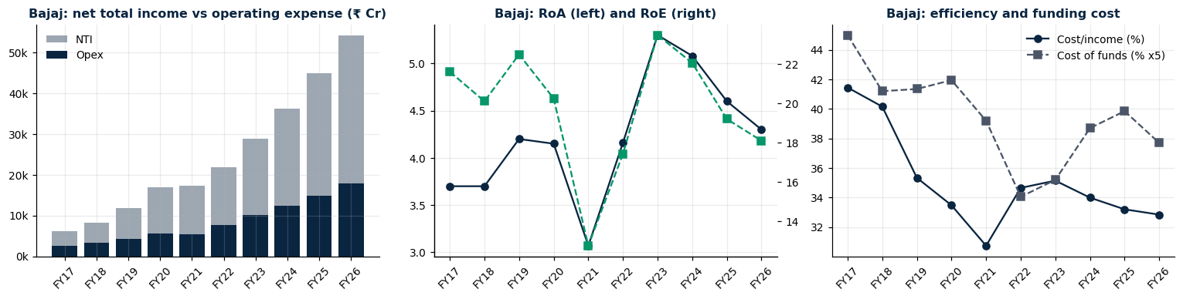
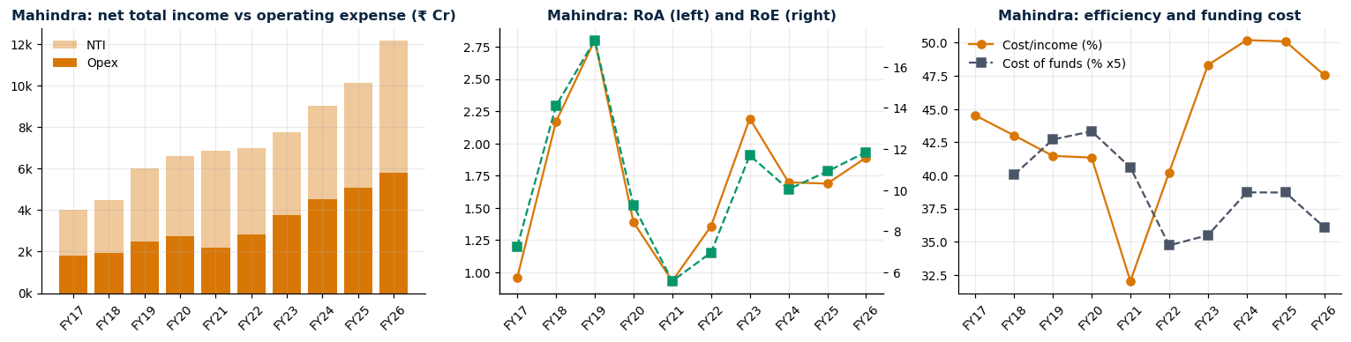
Capacity over time: Bajaj's returns are stable, Mahindra's swing with credit cost
Bajaj Finance (Figure 4)
RoA 4.30%
RoE 18.1%
Cost-to-income 32.8% (41.5% in FY17)
Peak RoA about 5.3% (FY23)
Mahindra Finance (Figure 9)
RoA 1.89%
RoE 11.85%
Cost-to-income 47.6% (about 50% in FY24-25)
RoA swung 0.93% to 2.8%
Notes:
Top row Bajaj, bottom row Mahindra. Left panels: net income against operating expense. Middle: RoA and RoE. Right: cost-to-income and cost of funds. Bajaj's cost-to-income fell from 41.5 to about 33 percent: this structural efficiency is the foundation of its high RoA. Mahindra's returns are volatile and credit-cost driven; its best years, FY19 and FY23, are exactly the low credit cost years. The dip in Mahindra's cost-to-income in FY21 is not efficiency: income held up while the book shrank. Note that Bajaj's peak in FY23 came from the lowest credit cost and cheap funding, and both have turned against it since. Transition: is Bajaj's higher RoE just more borrowing? The DuPont split answers that.

Slide 11
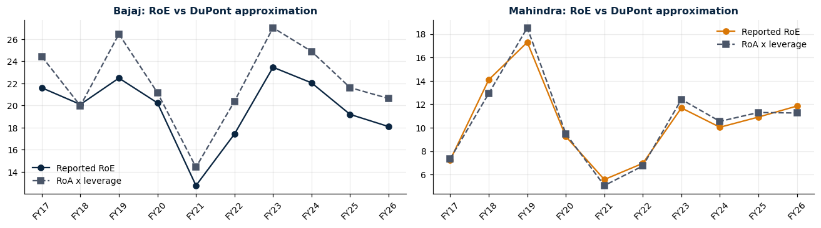
Bajaj's RoE lead is from earnings, not borrowing
FY26 RoE gap decomposition (pts) | Value
RoA effect (at Mahindra leverage) | +14.4
Leverage effect (at Bajaj RoA) | -5.0
DuPont approximation of the gap | +9.4
Reported RoE gap (Bajaj - Mahindra) | +6.2
Residual (averaging / definitions) | -3.1
Notes:
DuPont splits return on equity into return on assets times leverage. In the chart, the solid line is reported RoE and the dashed line is RoA times leverage. For Mahindra they match; for Bajaj the approximation runs about 2.5 points higher, probably because we use year-end rather than average equity, which is not verified. In the table: if Bajaj earned its own RoA but used Mahindra's higher leverage, its RoE would be 14.4 points higher. Mahindra's extra leverage offsets about 5 points. Reported RoE gap is 6.2 points with a 3.1 point residual from averaging and definitions. The message: Bajaj's return advantage is operational, not financial engineering, which is a higher-quality kind of return. Transition: leverage also belongs to the next C, Capital.

Slide 12
Capital: four ratios show how much loss each can absorb
CAPITAL
Ratio | Formula | How to read it | Bajaj FY26 | Mahindra FY26
CRAR | Total capital ÷ risk-weighted assets × 100 | Loss-absorbing buffer relative to risk taken. RBI minimum 15%. Higher = safer. | 21.55% | 18.80%
Tier 1 ratio | Tier 1 (core) capital ÷ risk-weighted assets × 100 | Highest-quality capital (mainly equity). RBI minimum 10%. | 20.67% | 16.70%
Headroom | CRAR − 15% (percentage points) | Room to grow or take losses before hitting the minimum. Bigger = safer. | 6.55 pts | 3.80 pts
Leverage | Total assets ÷ equity (x) | Reliance on borrowing. Higher = more debt per ₹1 of equity, so less margin for error. | 4.80x | 5.96x
Both cushions are thinner than in FY21-22. Mahindra's is the thinner one.
Notes:
Capital is the cushion that absorbs losses before lenders are hurt. CRAR is total capital divided by risk-weighted assets; the RBI minimum for these companies is 15 percent. Tier 1 is the core, highest-quality part of that capital, with a 10 percent minimum. Headroom is simply CRAR minus 15, the room before the minimum: Bajaj has 6.55 points, Mahindra 3.8. Leverage is assets divided by equity: Bajaj at 4.8 times, Mahindra at about 6 times, so Mahindra is more dependent on borrowing. Mahindra's ratios are described in source notes as standalone regulatory ratios, so they are not perfectly like for like with Bajaj's consolidated ones. We also have a debt-to-equity series, but Bajaj's inputs are estimated, so we do not rely on it. Transition: the chart shows how the cushions evolved.

Slide 13
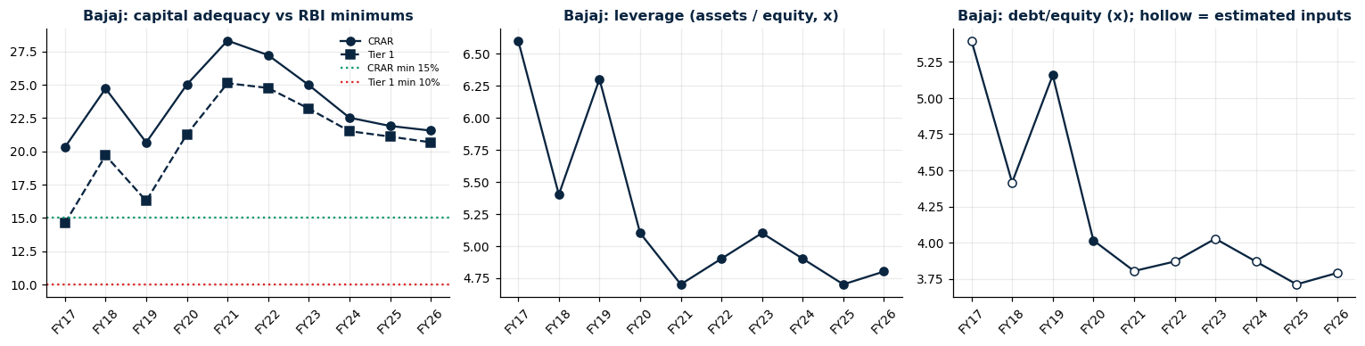
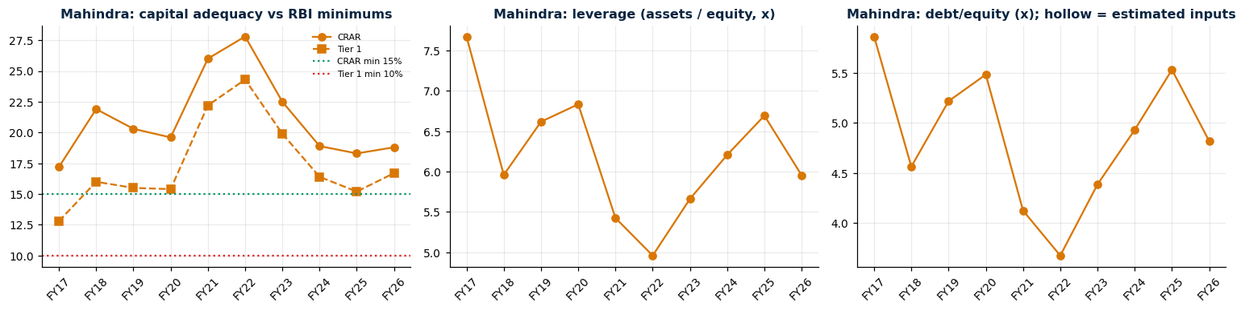
Capital over time: both built a cushion, then used it to grow
Bajaj Finance (Figure 5)
CRAR peaked 28.3% (FY21), now 21.55%
Headroom 13.3 pts to 6.55 pts
Leverage flat at 4.7-5.1x since FY21
Mahindra Finance (Figure 10)
CRAR peaked 27.8% (FY22), now 18.8%
Headroom only 3.8 pts
Leverage back near 6x, as before COVID
Notes:
Top row Bajaj. Left panel: CRAR and Tier 1 against the 15 and 10 percent minimums. Bajaj built a big cushion before COVID and has been using it to fund growth: headroom has halved from 13.3 to 6.55 points, still comfortable. Because its leverage is roughly flat while CRAR keeps falling, this points to more risk-weighted assets per rupee of assets, which is our inference from the pattern, not something we tested. Bottom row Mahindra: capital rose in the stress years because growth stalled, then was consumed when growth returned, and leverage went back to pre-COVID levels. Its 3.8 point cushion is adequate but thin for a company whose bad loans are still above its peer's. Treat debt-to-equity panels as indicative because the Bajaj inputs are estimated. Transition: Capital absorbs losses, so next we look at how many losses are coming, the quality of the loan book.

Slide 14
Collateral: for a lender, this means the quality and security of the loan book
COLLATERAL
Ratio | Formula | How to read it | Bajaj FY26 | Mahindra FY26
Gross NPA % | Gross NPA ÷ gross loans × 100 | Share of loans where borrowers have stopped repaying. Lower = better. | 1.01% | 3.34%
Net NPA % | (Gross NPA − provisions) ÷ (gross loans − provisions) × 100 | Bad loans left after provisions: the part not yet covered. Lower = better. | 0.41% | 1.40%
PCR | Provisions held against NPA ÷ gross NPA × 100 | How much of the bad-loan stock is already covered. Higher = safer. | 60.0% | 58.9%
Stage 2 % | Stage 2 loans ÷ total loans × 100 | Early-warning loans (risk up, not yet NPA). Rising = trouble ahead. | 0.94% | 4.71%
Unsecured share | Unsecured loans ÷ segment AUM × 100 | Loans with no collateral behind them. Higher = bigger loss if borrowers default. | ≈45.5% | ≈5%*
High-risk share | High-risk segment AUM ÷ segment AUM × 100 | Share in products classed as high risk. Lower = safer. | 37% | 11.6%
* Mahindra's unsecured share (SME, bills, trade, mixed at 50%) is defined differently from Bajaj's and is not directly comparable.
Notes:
For a bank or NBFC, collateral in the 7 Cs is best read as the quality of the loan book and how much security stands behind it. Six ratios. Gross NPA is the share of loans where borrowers have stopped paying. Net NPA is what is left after provisions, the uncovered part. PCR, provision coverage, says how much of the bad-loan stock is already provided for. Stage 2 is the early-warning bucket: loans whose risk has risen sharply but are not yet NPA, so it moves before NPA does. Unsecured share and high-risk share are compiler-classified measures of mix. Caution: Mahindra's unsecured share is defined differently, so do not compare 45.5 with 5 directly. Mahindra's Stage 2 of 4.7 percent against Bajaj's 0.9 percent is a clear warning level difference. Transition: the charts follow these ratios over time.

Slide 15
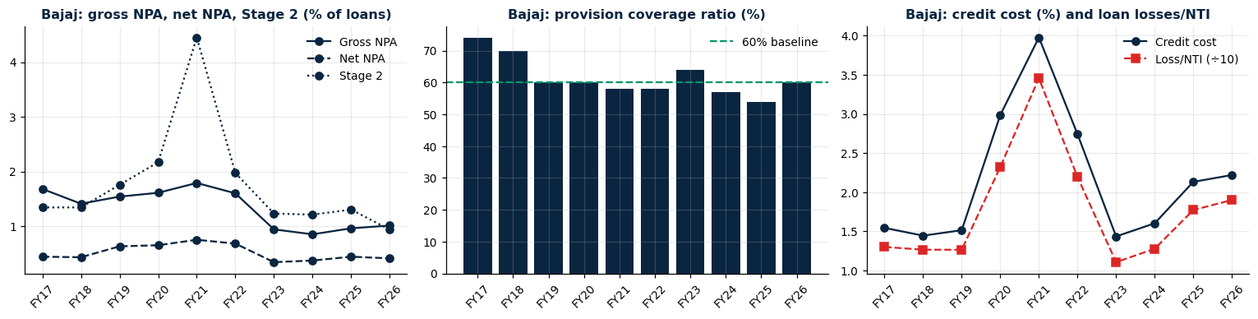
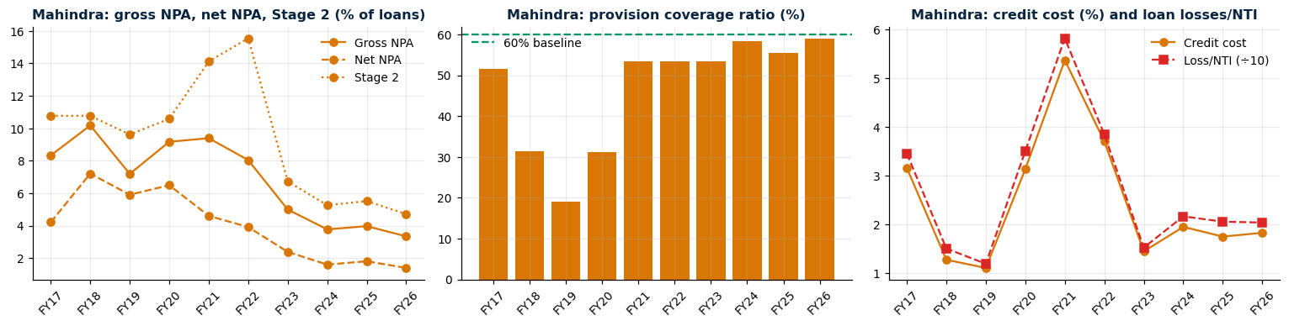
Collateral: Mahindra's bad-loan stock fell sharply but is still 3x Bajaj's
Bajaj Finance (Figure 3)
Gross NPA 1.01% (peak 1.79%)
Stage 2 spike 4.45% in FY21
PCR 60%
Credit cost 2.22%, up 3 years
Mahindra Finance (Figure 8)
Gross NPA 3.34% (peak 10.18%)
Stage 2 peak about 15.5% (FY22)
PCR 58.9% (19% in FY19)
Credit cost 1.83%
Notes:
Left panels show gross NPA, net NPA and Stage 2; middle is provision cover; right is credit cost. Bajaj, top: gross NPA never moves outside 0.9 to 1.8 percent. COVID shows up in Stage 2 and credit cost, not in reported bad loans, and regulatory relief on NPA recognition during the pandemic also dampened reported NPA. The watch point: credit cost has risen three years running, from 1.43 to 2.22 percent, while gross NPA is flat near 1 percent. The data show the trend, not the cause. Mahindra, bottom: it carried a legacy of high bad loans and very low provision cover in FY18 to FY20. The improvement since FY23 is real and large, about 7 points down from peak, and cover is now close to 60 percent. Stage 2 peaked a year later than Bajaj's, consistent with a longer stress cycle. Transition: the mix of the loan book explains part of the risk.

Slide 16
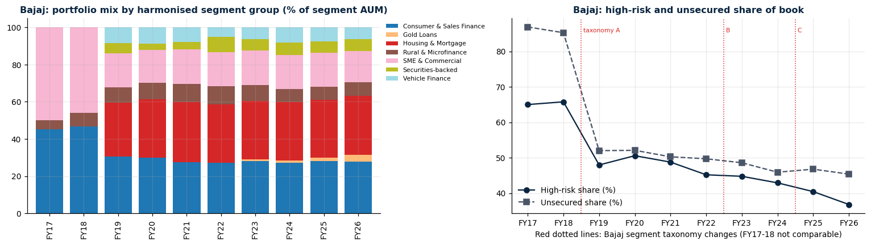
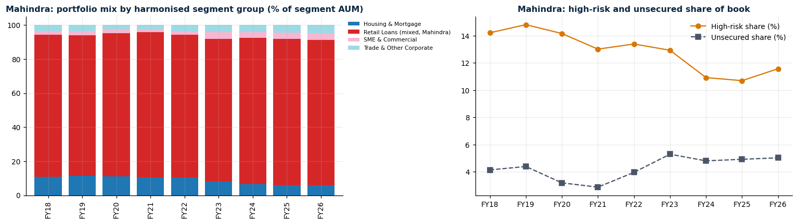
Loan mix: Bajaj is diversified but unsecured, Mahindra is concentrated
Bajaj Finance (Figure 6)
Housing & mortgage 31.8%
Consumer 27.8%, SME 16.7%
High-risk share 66% to 37%
Unsecured 45.5%
Mahindra Finance (Figure 11)
Retail loans 85.4% of book
Housing 11% to 6%
High-risk share 11.6%
86.8% of growth from retail
Notes:
Bajaj, top: seven product groups with mortgages now the largest; the high-risk share has fallen from about 66 to 37 percent, though the step at FY19 is mostly a relabelling of segments, since FY17 and FY18 used a five-segment scheme. Even so, close to half the book is unsecured, the main structural source of credit cost risk and a likely backdrop to its rising credit cost. Mahindra, bottom: retail loans are 83 to 86 percent of the book, and 86.8 percent of growth came from them. The concentration index rose from 7,070 to 7,346. This is a different risk: low unsecured exposure but dependence on one product. Neither mix is automatically safer. Transition: let us look under Bajaj's 1.01 percent headline.

Slide 17
Conditions: tighter consumer-credit rules weigh on both, more on Bajaj
CONDITIONS
Nov 2023: RBI raised risk weights on consumer credit and bank lending to NBFCs. This raises capital needs for unsecured books
Bajaj: about 45% unsecured, so credit cost is more sensitive to consumer stress (1.43% to 2.22% in three years)
Mahindra: 85% retail loans in rural and semi-urban India, tied to vehicle demand, monsoons, rural incomes
Falling policy rates help both via funding costs. A downturn hits Mahindra's thinner capital first
“Gold Loan Blip” : Hidden risk for lender
On Aug 6, 2026, RBI proposed a rule that NBFCs shall only offer credit products like term loans. It may affect Bajaj Finance.
How each fared in the FY21 shock | Bajaj | Mahindra
AUM growth, FY21 | ≈4% | -5.5%
Credit cost, FY21 | 3.98% | 5.38%
RoA, FY21 | 3.07% | 0.93%
Credit Risk Index, FY21 | 33.2 | 73.6
Notes:
Conditions covers the environment: rates, regulation, the economic cycle. We do not compute a ratio for it. What we can do is show how each company behaved when conditions turned, which is the COVID year FY21 in the table. Bajaj's growth slowed to about 4 percent and its credit cost jumped to 3.98 percent; Mahindra's book shrank and its credit cost hit 5.38 percent; its index score was 73.6 against 33.2. On rules: in November 2023 the RBI raised risk weights on consumer credit and on bank lending to NBFCs, which raises capital needs for unsecured, consumer-heavy books like Bajaj's. Mahindra is tied to vehicle demand, monsoons and rural incomes. Falling policy rates would help both via funding cost, while a downturn hits Mahindra's thinner capital first. Please confirm regulatory details against RBI circulars. Transition: next, funding and liquidity.

Slide 18
Cash flow and funding: cost of funds is almost identical now
CASH FLOW
Ratio | Formula | How to read it | Bajaj FY26 | Mahindra FY26
Cost of funds | Interest expense ÷ average borrowings × 100 | What it costs to raise money. Lower = more margin. Similar for both = not a differentiator. | 7.54% | 7.22%
Leverage | Total assets ÷ equity (x) | Reliance on borrowing. Higher = more refinancing need. | 4.80x | 5.96x
ALM gap / liquidity | Inflows − outflows by maturity bucket; liquid assets ÷ 30-day net outflows | Shows whether cash arrives before it must go out. Not in our dataset. | n/a | n/a
Funding cost has moved together since FY22
Mahindra relies more on borrowing (5.96x vs 4.8x)
Gap: ALM and liquidity data not in our dataset
Notes:
Cash flow for a lender means funding and liquidity: can it raise money at a sensible cost and meet its obligations as they fall due? We have two ratios. Cost of funds is interest expense divided by average borrowings: 7.54 percent for Bajaj and 7.22 percent for Mahindra, and the chart shows the two have moved together since FY22. So funding cost does not separate them. Leverage, already seen, is 4.8 times against 5.96 times, so Mahindra relies more on borrowing. Be honest about the gap: ALM gaps, liquidity coverage and funding mix are not in the dataset, so this C is only partly covered. Those should be added from investor presentations. Transition: finally Covenants and context.

Slide 19
Covenants and context: both carry top ratings, supported by group ties
COVENANTS AND CONTEXT
What we know
What we did not do
Both rated AAA (highest domestic level) by major agencies, lowering funding cost and widening market access
Mahindra: rating helped by expected support from Mahindra & Mahindra
Bajaj: relies on its own franchise and the Bajaj Finserv group
Rating triggers and covenants on bank and bond borrowings are in debt disclosures; not modelled
Stress test to add: effect on access and cost of funds if a rating moves down a notch
Notes:
The last C covers ratings, group support and the terms attached to borrowings. We do not model it. Both lenders have been rated at the highest domestic long-term level, AAA, by major agencies, which lowers funding cost and widens market access. Mahindra's rating benefits from expected support from Mahindra and Mahindra, while Bajaj relies mainly on its own franchise and the Bajaj Finserv group. Rating triggers and covenants are in the debt disclosures. A useful extension would be a stress test of what happens to access and cost of funds if a rating moves down a notch. Please check current ratings and outlooks in the CRISIL, ICRA and India Ratings reports. Transition: now we put all the evidence together in one view.

Slide 20
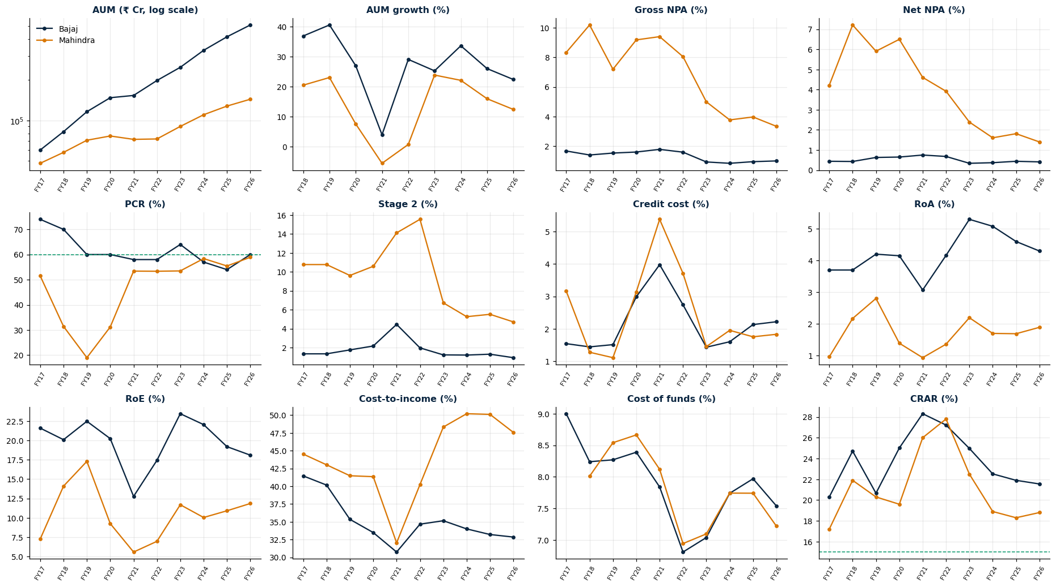
Seven Cs, twelve metrics: Bajaj leads, the gaps narrow after FY22
Notes:
This page puts twelve key metrics for both companies on one chart each, Bajaj in navy and Mahindra in amber. Read it as the evidence summary for the Cs. Capacity: RoA and RoE, Bajaj above in every year. Collateral: gross NPA, net NPA and Stage 2, Mahindra far higher but converging after FY22; PCR converging at about 59 to 60 percent. Credit cost: both spike in FY21 and converge from FY23. Capital: CRAR for both peaks in FY21 to 22 and falls. Cash flow: cost of funds nearly identical since FY22. This is the bridge to the index: the same variables are what we score next. Transition: a single score lets us rank and test the result.

Slide 21
Verdict by C:
C | Stronger | Key evidence
Character | Mixed | Bajaj: best underwriting record, but 2023 RBI action. Mahindra: parent backing, long tail of bad loans
Capacity | Bajaj | RoA 4.30% vs 1.89%; cost-to-income 32.8% vs 47.6%. Credit cost now higher at Bajaj
Capital | Bajaj | Headroom 6.55 vs 3.8 pts; leverage 4.8x vs 5.96x. Both cushions are shrinking
Collateral | Bajaj | GNPA 1.01% vs 3.34%; Stage 2 0.94% vs 4.71%. But about 45% of Bajaj is unsecured
Conditions | Both exposed | Bajaj to consumer-credit rules; Mahindra to the rural cycle and thin capital
Cash flow | Roughly level | Cost of funds 7.54% vs 7.22%. ALM and liquidity not in our data
Covenants / context | Roughly level | Both AAA; Mahindra helped by parent support
Overall | Bajaj: lower risk | Credit Risk Index FY26: 18.8 (Low) vs 33.1 (Moderate)
Notes:
This table is the 7 Cs scorecard. Walk down the right-hand column. Character is mixed: Bajaj has the better underwriting record but a recent regulatory action, while Mahindra has parent backing but a long tail of bad loans. Capacity, Capital and Collateral clearly favour Bajaj. Conditions hit both through different channels. Cash flow is roughly level on cost of funds, with Mahindra more leveraged. Covenants and context are level, both AAA. The overall verdict: Bajaj is the lower credit risk. Transition: the Credit Risk Index turns the measurable parts of this verdict into one number we can track and stress-test.

Slide 22
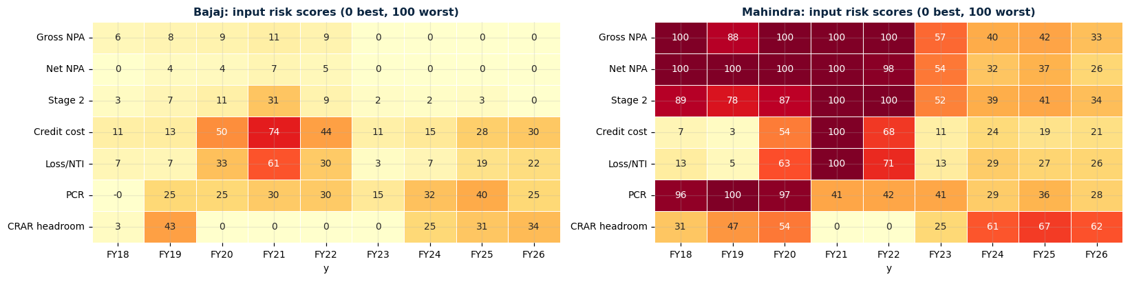
Input scores show why: Mahindra's risk is the stock of bad assets
What the chart shows
What it means
Each input scored 0-100; darker red = riskier.
Mahindra scores 100 on gross and net NPA through FY22.
Mahindra: stock of bad assets and thin cover. Bajaj: small, flow-based, with a thinner buffer.
Mahindra's capital-headroom score (61-67) is its second-worst input now.
Notes:
This heat map shows why each index value is what it is. Mahindra is dark red on gross and net NPA through FY22, and on provision cover in FY18 to FY20. Those have eased but not vanished, still 26 to 34 in FY26. Bajaj is pale, with hot cells only in FY21, and moderate scores of 25 to 34 for capital headroom in FY24 to FY26. So Bajaj's risk is small and flow-based, with a thinning buffer, a different profile from Mahindra's. Notice Mahindra's capital headroom score is 61 to 67, its second-worst input today, so the improvement is not uniform. Transition: grouping the inputs into pillars shows the stock versus flow story.

Slide 23
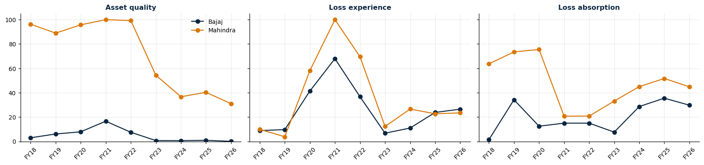
By pillar: current losses are alike, inherited asset quality is not
What the chart shows
What it means
Asset quality: Bajaj under 20; Mahindra 90-100 until FY22, 31 in FY26.
Loss experience: both converge at 23-26 in FY25-26.
Today's gap is inherited asset quality and thinner buffers, not current losses.
Loss absorption scores rise for both after FY23 as capital headroom falls.
Notes:
Three panels, one per pillar. Asset quality, the stock of bad assets: Bajaj stays below 20, Mahindra sits at 90 to 100 until FY22 and falls to about 31. Loss experience, the flow of current losses: the two almost move together, both peaking in FY21 and converging at 23 to 26 in FY25 and FY26. Loss absorption, the buffers: Mahindra is riskier in every year, and both rise again after FY23 as headroom falls, a shared trend to watch. A statistical look, PCA, found two distinct dimensions, a stock and a flow, which is why this chart separates them. Transition: here is the total score over time.

Slide 24
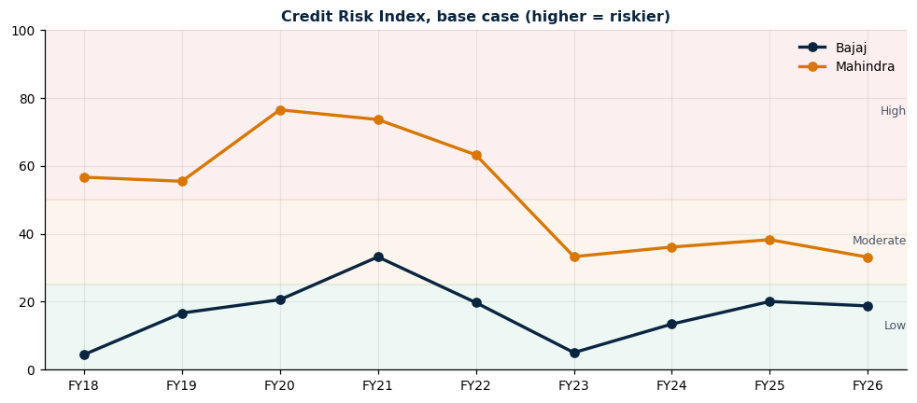
Index over time: Mahindra moved from High to Moderate, Bajaj stays Low
What the chart shows
Bajaj: 4.4 (FY18), 33.2 (FY21), 5.0 (FY23), 18.8 (FY26).
Mahindra: 76.5 (FY20 peak), 33.1 (FY26).
What it means
Mahindra improved 43 points; most came in FY23.
Bajaj drifted up 14 points from its FY23 low. Read ranking and trend, not exact levels.
Index | FY18 | FY19 | FY20 | FY21 | FY22 | FY23 | FY24 | FY25 | FY26
Bajaj | 4.4 | 16.7 | 20.6 | 33.2 | 19.7 | 5.0 | 13.4 | 20.1 | 18.8
Mahindra | 56.6 | 55.4 | 76.5 | 73.6 | 63.2 | 33.3 | 36.1 | 38.2 | 33.1
Gap (M - B) | 52.2 | 38.7 | 55.9 | 40.4 | 43.5 | 28.3 | 22.7 | 18.1 | 14.3
Notes:
Mahindra was in the High band, above 50, through FY22 and has been Moderate since FY23, an improvement of 43 points from its FY20 peak. Bajaj stays Low except in FY21, but has drifted up 14 points from its FY23 low of 5.0 to 18.8. The table gives the gap: 40.4 in FY21 narrowing to 14.3 in FY26. The 25 and 50 band boundaries are judgement, so read levels as indicative and the ranking and trend as the robust output. Transition: what drives the remaining 14 points?

Slide 25
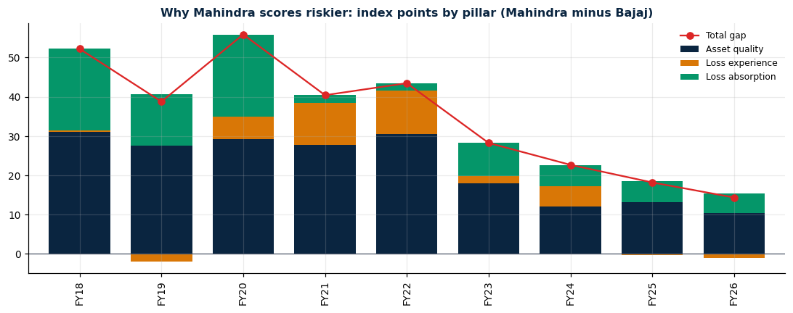
Why Mahindra scores riskier: bad-asset stock and buffers, not current losses
What the chart shows
Gap: 52 (FY18), 40 (FY21), 14.3 (FY26).
FY26: asset quality +10.3, loss experience -1.0, loss absorption +5.0.
What it means
Asset quality drives the gap in almost every year.
Mahindra is riskier on inherited bad assets and thinner buffers, not on current losses.
Notes:
This is the key insight chart. The stacked bars split the Mahindra minus Bajaj gap by pillar. In FY26 the 14.3 point gap is asset quality plus 10.3, loss absorption plus 5.0, and loss experience minus 1.0. Loss experience is slightly negative because Bajaj's credit cost of 2.22 percent is now higher than Mahindra's 1.83 percent. That is the clearest evidence of convergence: Mahindra is not riskier on current losses, it is riskier on its inherited stock of bad assets and thinner buffers. If someone asks why Mahindra scores higher if credit costs are similar, this is the answer. Transition: can we trust this ranking? We test it.

Slide 26
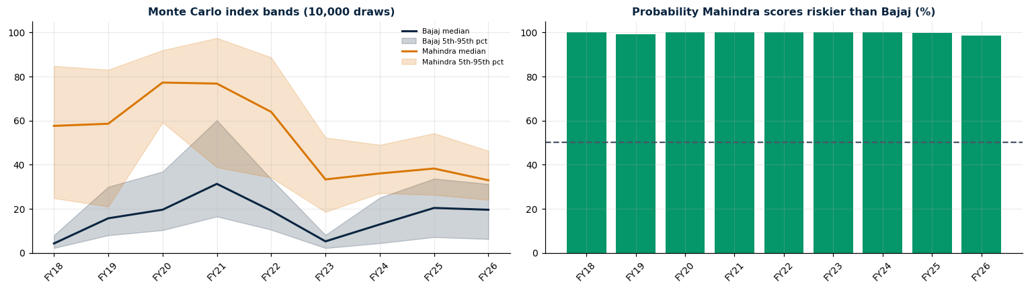
Direction is certain, magnitude is not: Monte Carlo over 10,000 draws
What the chart shows
What it means
Left: median and 5th-95th percentile bands from 10,000 draws of weights and thresholds (±25%).
Right: share of draws where Mahindra is riskier; every year 98-100%.
Mahindra is riskier in at least 98.5% of draws in every year.
Bands overlap in FY19, FY21, FY25 and FY26, so the exact gap size is uncertain.
Notes:
We randomly varied the pillar weights and threshold strictness 10,000 times. Mahindra came out riskier in at least 98.5 percent of draws every year; the lowest is FY26. But the bands overlap in four years, including the latest two, so we can say Mahindra is riskier but not precisely by how much. Mahindra's band is wider in early years because its inputs sit at the extremes of the threshold scale, where the choice matters most. Transition: finally, what the index can and cannot do.

Slide 27
Conclusion: Mahindra is the riskier credit, and both have watch points
Bajaj Finance: watch
Mahindra Finance: watch
Credit cost up three years running (1.43% to 2.22%)
About 45% unsecured exposure
Capital cushion halved to 6.55 pts
PCR near 60%
Vehicle finance GNPA about 3%, SME GNPA rising to 1.6%
FY27 - The “Gold Loan Blip” is a hidden risk for lenders
GNPA still 3.3x Bajaj's
Cost-to-income near 48%
Thin 3.8 pt capital cushion
About 85% in one product
Retail concentration rising (HHI 7,346)
Notes:
Wrap up with the three messages. One, the ranking: Mahindra is the riskier credit in every year and under every method; that is our most robust finding. Two, direction of travel: Mahindra's risk has fallen 43 points from its peak and Bajaj's has risen 14 points from its FY23 low, so the gap narrowed from 40 to 14 points. Three, the remaining gap is old bad loans and thinner buffers, not current losses. The watch lists: for Bajaj, rising credit cost, a halved capital cushion and a large unsecured book; for Mahindra, bad loans still 3.3 times Bajaj's, high costs, a thin cushion and single-product concentration. Mahindra is a turnaround story; Bajaj is strong but its risk is creeping up.

Slide 28
Limitations and next steps
CONCLUSIONS
Limitations
Next steps
Two companies, nine Ind AS years: a case study, not a sector view
Thresholds are judgement; quote levels as ranges
Some Bajaj inputs estimated; segment GNPA partly allocated
3 of 7 Cs qualitative; no ALM or liquidity data
Correlations are not causes
Add 6-8 peer NBFCs
Add a funding and ALM pillar
Add macro variables: repo rate, GDP, rural income
Verify qualitative facts against RBI and rating reports
Notes:
Close with honesty about limits. This is two companies over nine years, so a descriptive case study and not evidence about the whole sector. The thresholds are our judgement; the ranking is stable to reasonable changes, but absolute levels are not. Some Bajaj balance-sheet fields are estimated. Segment bad-loan data are partly allocated by the compiler. Capital ratios are used as given. Three of the seven Cs are qualitative and the cash flow C lacks ALM and liquidity data. Correlations are descriptive and do not prove cause. Next steps: add six to eight peer lenders, add a funding and ALM pillar so Cash flow is fully covered, and add macro variables like the repo rate and rural income. Then invite questions; backup tables are in the appendix.

Slide 29
Backup: FY21 (COVID) and FY26 snapshot
APPENDIX: BACKUP
Metric | Bajaj FY21 | Bajaj FY26 | Mahindra FY21 | Mahindra FY26
AUM (₹ Cr) | 152,947 | 509,975 | 72,240 | 143,405
3-yr AUM CAGR (%) | 22.9 | 27.3 | 7.7 | 16.8
Gross NPA (%) | 1.79 | 1.01 | 9.39 | 3.34
Net NPA (%) | 0.75 | 0.41 | 4.61 | 1.40
Provision coverage (%) | 58.0 | 60.0 | 53.4 | 58.9
Stage 2 (%) | 4.45 | 0.94 | 14.12 | 4.71
Credit cost (%) | 3.98 | 2.22 | 5.38 | 1.83
RoA (%) | 3.07 | 4.30 | 0.93 | 1.89
RoE (%) | 12.77 | 18.10 | 5.57 | 11.85
Cost-to-income (%) | 30.7 | 32.8 | 32.0 | 47.6
Cost of funds (%) | 7.84 | 7.54 | 8.12 | 7.22
CRAR (%) | 28.31 | 21.55 | 26.00 | 18.80
Tier 1 (%) | 25.11 | 20.67 | 22.20 | 16.70
Leverage (x) | 4.70 | 4.80 | 5.43 | 5.96
Notes:
Use this table if someone asks how both companies moved between the stress year and today. Both reduced bad loans, Stage 2 and credit cost, and both raised RoA and RoE. But Mahindra improved from a much weaker start and ends with levels Bajaj already had. Two items moved the wrong way for Bajaj: its capital ratio fell 6.8 points and cost-to-income rose slightly. Mahindra's cost-to-income rose sharply from 32.0 to 47.6 and its capital ratio fell 7.2 points.

Slide 30
Backup: Mahindra product growth and Bajaj segment contribution
APPENDIX
Mahindra product | FY18 (₹ Cr) | FY26 (₹ Cr) | CAGR % | Share FY26 % | Share of growth %
Retail loans | 48,170 | 122,410 | 12.4 | 85.4 | 86.8
Housing finance | 6,312 | 8,512 | 3.8 | 5.9 | 2.6
SME financing | 1,361 | 5,741 | 19.7 | 4.0 | 5.1
Trade advances | 1,437 | 3,163 | 10.4 | 2.2 | 2.0
Bills of exchange | 550 | 2,350 | 19.9 | 1.6 | 2.1
Finance lease | 0 | 1,229 | n/a | 0.9 | 1.4
Bajaj segment group | FY19 (₹ Cr) | FY26 (₹ Cr) | CAGR % | Share of growth %
Housing & Mortgage | 33,870 | 162,077 | 25.1 | 32.5
Consumer & Sales Finance | 35,263 | 141,915 | 22.0 | 27.1
SME & Commercial | 21,427 | 85,409 | 21.8 | 16.2
Rural & Microfinance | 9,243 | 37,991 | 22.4 | 7.3
Securities-backed | 6,359 | 33,247 | 26.7 | 6.8
Vehicle Finance | 9,726 | 31,505 | 18.3 | 5.5
Gold Loans | 0 | 17,831 | n/a | 4.5
Notes:
Two tables on product growth. Mahindra: retail loans are 86.8 percent of growth and 85.4 percent of the FY26 book, housing has grown only 3.8 percent a year, and the smaller products grow fast from a tiny base. Bajaj: growth is broad-based, led by mortgages at 32.5 percent and consumer and sales finance at 27.1 percent; securities-backed is the fastest at 26.7 percent a year. Bajaj changed its segment labels in FY19, FY23 and FY25, so group figures are the compiler's harmonised mapping.

Slide 31
which relationships are stable, and does mix move with bad loans?
Company | Pair | All years | Ex FY21 | YoY
Bajaj | Growth vs credit cost | -0.81 | -0.50 | -0.71
Bajaj | Credit cost vs RoE | -0.87 | -0.68 | -0.86
Bajaj | Stage 2 vs credit cost | 0.85 | 0.60 | 0.77
Bajaj | Gross NPA vs PCR | 0.11 | 0.24 | -0.51
Mahindra | Growth vs credit cost | -0.95 | -0.92 | -0.92
Mahindra | Credit cost vs RoE | -0.88 | -0.86 | -0.87
Mahindra | Stage 2 vs credit cost | 0.69 | 0.59 | 0.68
Mahindra | Gross NPA vs PCR | -0.60 | -0.74 | 0.66
Company | Mix link | r (levels) | r (changes)
Bajaj | High-risk vs GNPA | 0.76 | -0.08
Bajaj | Unsecured vs GNPA | 0.84 | 0.14
Bajaj | High-risk vs Stage 2 | 0.64 | 0.32
Mahindra | High-risk vs GNPA | 0.81 | -0.25
Mahindra | Unsecured vs GNPA | -0.83 | -0.76
Mahindra | Unsecured vs credit cost | -0.79 | -0.92
Descriptive only: levels move together because of shared trends. Not evidence of cause.
Notes:
Credit cost against RoE is negative and stable for both, as expected. Stage 2 against credit cost is positive in all versions, supporting Stage 2 as an early-warning indicator. For Bajaj the growth against credit cost link falls from minus 0.81 to minus 0.50 without FY21, so it is mostly COVID. Gross NPA against PCR flips sign for Mahindra, so draw no conclusion. For mix versus bad loans: in levels, higher unsecured and high-risk shares go with higher bad loans, but the link disappears in year-on-year changes, so it is probably a shared trend, not evidence. Mahindra's negative link between unsecured share and credit cost holds in changes, but its unsecured share is only about 5 percent, so this is not evidence that unsecured lending reduces losses.

Slide 32
Backup: Credit Risk Index scenario results
Scenario | Bajaj FY26 | Mahindra FY26 | Bajaj FY21 | Mahindra FY21 | Mahindra riskier
Base case (equal weights) | 18.8 | 33.1 | 33.2 | 73.6 | 9/9
Asset-quality heavy (50/25/25) | 14.1 | 32.6 | 29.0 | 80.2 | 9/9
Loss-flow heavy (25/50/25) | 20.7 | 30.7 | 41.9 | 80.2 | 9/9
Buffer heavy (25/25/50) | 21.5 | 36.0 | 28.6 | 60.4 | 9/9
PCR-only buffer (no capital) | 17.2 | 27.4 | 38.2 | 80.5 | 9/9
Tighter thresholds (x0.75) | 25.0 | 44.1 | 44.2 | 75.9 | 9/9
Looser thresholds (x1.25) | 15.0 | 26.5 | 26.5 | 67.9 | 9/9
PCA weights (relative) | 10.8 | 30.4 | 35.6 | 100.0 | 9/9
Worst pillar (non-compensatory) | 29.7 | 44.8 | 67.9 | 100.0 | 9/9
Geometric mean (non-compensatory) | 8.6 | 32.0 | 25.9 | 59.5 | 9/9
Notes:
Mahindra scores riskier in 9 of 9 years in every scenario. In FY26 Bajaj ranges from 8.6 to 29.7 and Mahindra from 26.5 to 44.8. A PCA on the seven scored inputs found one dominant component explaining 58 percent of variance, with heaviest loadings on gross NPA, net NPA and Stage 2, and almost none on capital headroom, which fits the stock versus flow structure.

